Slide 1


International Economics: Theory and Policy
Twelfth Edition
Chapter 12
Controversies in Trade Policy
Copyright © 2022, 2018, 2015 Pearson Education, Inc. All Rights Reserved
Notes:
If this PowerPoint presentation contains mathematical equations, you may need to check that your computer has the following installed:
1) MathType Plugin
2) Math Player (free versions available)
3) NVDA Reader (free versions available)

Slide 2
Learning Objectives (1 of 2)
12.1 Summarize the more sophisticated arguments for interventionist trade policy, especially those related to externalities and economies of scale.
12.2 Evaluate the claims of the anti-globalization movement related to trade effects on workers, labor standards, and the environment in light of the counterarguments.

Slide 3
Learning Objectives (2 of 2)
12.3 Discuss the role of the World Trade Organization (W T O) as a forum for resolving trade disputes and the tension between the rulings of the W T O and individual national interests.
12.4 Discuss key issues in the debate over trade policy and the environment.

Slide 4
Preview
Arguments for “activist” trade policies
Externality or appropriability problem
Strategic trade policy with imperfect competition
Aments concerning trade and people
Trade and low-wage labor
Trade and the environment
Trade and culture

Slide 5
Arguments for an Activist Trade Policy
An activist trade policy usually means government policies that actively support export industries through subsidies.
Arguments for activist trade policies use an assumption that import-substituting industrialization (Econ/Trade Chapter 11) and the cases against free trade (Econ/Trade Chapter 10) used: market failure.
Externalities or an appropriability problem
Imperfect competition that results in revenues that exceed all (opportunity) costs: “excess” profits.

Slide 6
Technology and Externalities (1 of 6)
Firms that invest in new technology generally create knowledge that other firms can use without paying for it: an appropriability problem.
By investing in new technology, firms are creating an extra benefit for society that is easily used by others.
An appropriability problem is an example of an externality: benefits or costs that accrue to parties other than the one that generates it.
An externality implies that the marginal social benefit of investment is not represented by producer surplus.

Slide 7
Technology and Externalities (2 of 6)
Governments may want to actively encourage investment in technology when externalities in new technologies create a high marginal social benefit.
Should the U.S. government subsidize high-technology industries?

Slide 8
Technology and Externalities (3 of 6)
When considering whether a government should subsidize high-technology industries, consider:
The ability of governments to subsidize the right activity.
Much activity by high technology firms has nothing to do with generating knowledge: subsidizing equipment purchases or non-technical workers generally does not create new technology.
Knowledge and innovation are created in industries that are not usually classified as high tech.

Slide 9
Technology and Externalities (4 of 6)
Instead of subsidizing specific industries, the United States subsidizes research and development through the tax code.
Research and development expenses can be deducted from corporate taxable income.
The economic importance of externalities.
It is difficult to determine the quantitative importance that externalities have on the economy.
Therefore, it is difficult to say how much to subsidize activities that create externalities.
Externalities may occur across countries as well.
No individual country has an incentive to subsidize industries if all countries could take advantage of the externalities generated in a country.

Slide 10
Technology and Externalities (5 of 6)
Some argue that the United States should have a deliberate policy of promoting high-technology industries and helping them compete against foreign rivals.
Fear in the 1980s that Japan’s dominance of the semiconductor memory market would translate into a broader dominance of computers and related technologies proved to be unfounded.

Slide 11
Technology and Externalities (6 of 6)
More recently, the decline in U.S. employment in the information, communication, and technology (I C T) industries, which are at the heart of the information technology revolution, and large U.S. trade deficits in I C T goods have renewed fears.

Slide 12
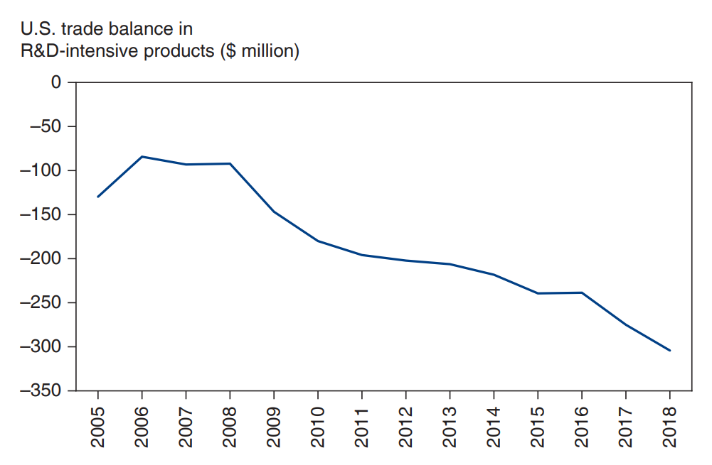
Figure 12.1 U.S. Trade Balance in R&D-Intensive Goods
Since 2005, the United States has developed a large trade deficit in R&D-intensive products, which are widely seen as the cutting edge of innovation.
Source: National Science Foundation, Science and Engineering Indicators 2012.
Notes:
The line graph plots the U S trade balance in R and D intensive products, in million dollars, versus year, 2005 to 20 18. The plot generally rises from (2005, negative 140) through (2006, negative 80) and falls to (2007, negative 100). The plot then falls through (20 10, negative 190), (20 15, negative 230) to (20 18, negative 310). All values are estimated.

Slide 13
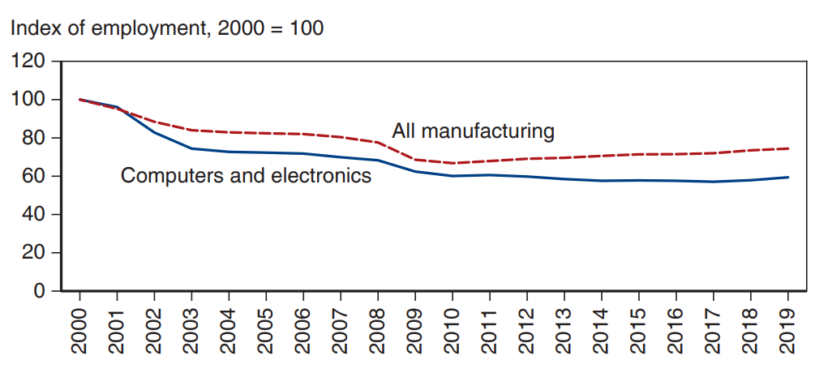
Figure 12.2 U.S. Manufacturing Employment
Since 2000, the number of workers producing computers and related goods in the United States has fallen sharply, outpacing the general decline in manufacturing employment.
Source: Bureau of Labor Statistics.
Notes:
The double line graph plots the index of employment with the year 2000 = 100, versus year, 2000 to 20 15, for all manufacturing and for computers and related goods. The plot for all manufacturing generally falls from (2000, 100) through (2005, 80) to (20 19, 90). The plot for computers and related goods generally falls from (2000, 100) through (2005, 70) to (20 19, 62). All values are estimated.

Slide 14
Imperfect Competition and Strategic Trade Policy (1 of 7)
Imperfectly competitive industries are typically dominated by a few firms that generate monopoly profits or excess profits.
Excess profits are revenues that exceed all opportunity costs: profits higher than what equally risky investments elsewhere in the economy earn.
In an imperfectly competitive industry, government subsidies can shift excess profits from a foreign firm to a domestic firm.

Slide 15
Imperfect Competition and Strategic Trade Policy (2 of 7)
Example (called the Brander-Spencer analysis):
Two firms (Boeing and Airbus) compete in the international market but are located in two different countries (United States and E U).
Both firms manufacture airplanes, but each firm’s profits depends on the actions of the other.
Each firm decides to produce or not depending on profit levels.

Slide 16
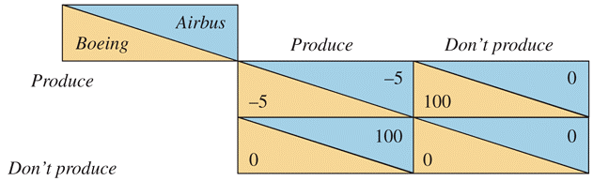
Table 12.1 Two-Firm Competition
Notes:
Both sides produce: Boeing, negative 5; Airbus, negative 5. Boeing produces, Airbus does not: Boeing, 100; Airbus, 0. Airbus produces, Boeing does not: Boeing, 0; Airbus, 100. Neither side produces: Boeing and Airbus, 0.

Slide 17
Imperfect Competition and Strategic Trade Policy (3 of 7)
The predicted outcome depends on which firms invest/produce first.
If Boeing produces first, then Airbus will not find it profitable to produce.
If Airbus produces first, then Boeing will not find it profitable to produce.
But a subsidy by the European Union can alter the outcome by making it profitable for Airbus to produce regardless of Boeing’s action.

Slide 18
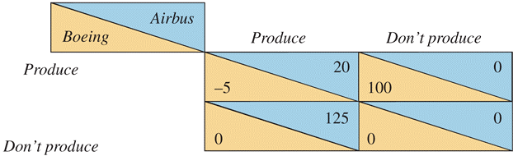
Table 12.2 Effects of a Subsidy to Airbus
Notes:
Both sides produce: Boeing, negative 5; Airbus, 20. Boeing produces, Airbus does not: Boeing, 100; Airbus, 0. Airbus produces, Boeing does not: Boeing, 0; Airbus, 125. Neither side produces: Boeing and Airbus, 0.

Slide 19
Imperfect Competition and Strategic Trade Policy (4 of 7)
If Boeing expects that the European Union will subsidize Airbus, Boeing will be deterred from entering the industry.
Thus, the subsidy of 25 will generate profits of 125 for Airbus.
The subsidy raises profits more than the amount of the subsidy itself due to its deterrent effect on foreign competition.

Slide 20
Imperfect Competition and Strategic Trade Policy (5 of 7)
A government policy to give a domestic firm a strategic advantage in production is called a strategic trade policy.

Slide 21
Imperfect Competition and Strategic Trade Policy (6 of 7)
Criticisms of this analysis include:
Practical use of strategic trade policy requires more information about firms than is likely available.
The predictions from the simple example differ if the numbers are slightly different.
What if governments or economists are not exactly right when predicting the profits of firms?
For example, what if Boeing has a better technology that only it can recognize, so that even if Airbus produces, Boeing still finds it profitable to produce?

Slide 22
Imperfect Competition and Strategic Trade Policy (7 of 7)
Foreign retaliation also could result:
If the European Union subsidizes Airbus, the United States could subsidize Boeing, which would deter neither firm from producing, start a trade war, and waste taxpayer funds.
Strategic trade policy, like any trade policy, could be manipulated by politically powerful groups.

Slide 23
Trade and Low-Wage Labor (1 of 6)
Manufactured exports from low- and middle-income countries have been increasing.
Compared to rich-country standards, workers who produce these goods are paid low wages and may work under poor conditions.
Some have opposed free trade for this reason.

Slide 24
Trade and Low-Wage Labor (2 of 6)
One example of this situation is the maquiladora sector: Mexican firms that produce for export to the United States.
Opponents of the North American Free Trade Agreement have argued that it is now easier for employers to replace high-wage workers in the United States with low-wage workers in Mexico.

Slide 25
Trade and Low-Wage Labor (3 of 6)
The above claim can be true, but we cannot conclude that trade hurts workers.
A Ricardian model predicts that while wages in Mexico should remain lower than those in the United States due to low productivity in Mexico, they will rise relative to their pretrade level.
A Heckscher-Ohlin model does predict that unskilled workers in the United States will lose from NAFTA, but it also predicts that unskilled workers in Mexico will gain.

Slide 26
Trade and Low-Wage Labor (4 of 6)
Despite the low wages earned by workers in Mexico, both theories predict that those workers are better off with trade than they would be if trade had not taken place.
Evidence consistent with these predictions would show that wages in maquiladoras have risen relative to wages in other Mexican sectors.
One could also compare working conditions in maquiladoras with the working conditions in other Mexican sectors, rather than with those in the United States.

Slide 27
Table 12.3 Real Wages
(A) Before Trade | High-Tech Goods/Hour | Low-Tech Goods/Hour
United States | 1 | 1
Mexico | 1 eighth | 1 half
(B) After Trade | High-Tech Goods/Hour | Low-Tech Goods/Hour
United States | 1 | 1
Mexico | 1 fourth | 1 half

Slide 28
Trade and Low-Wage Labor (5 of 6)
Some labor activists want to include labor standards in trade negotiations.
However, labor standards imposed by foreign countries are opposed by governments of low- and middle-income countries.
International standards could be used as a protectionist policy or a basis for lawsuits when domestic producers did not meet them.
Standards set by high-income countries would be expensive for low- and middle-income producers.

Slide 29
Trade and Low-Wage Labor (6 of 6)
A policy that could be agreeable for governments of low- and middle-income countries is a system that monitors wages and working conditions and makes this information available to consumers.
Products could be certified as made with acceptable wage rates and working conditions.
But this policy would have a limited effect, since a large majority of workers in low- and middle-income countries do not work in the export sector.

Slide 30
Trade and the Environment (1 of 5)
Compared to rich-country standards, environmental standards in low- and middle-income countries are lax.
Some have opposed free trade for this reason.
But we cannot conclude that trade hurts the environment, since consumption and production in the absence of trade have degraded the environment.

Slide 31
Trade and the Environment (2 of 5)
Some environmental activists want to include environmental standards in trade negotiations.
However, environmental standards imposed by foreign countries are opposed by governments of low- and middle-income countries.
International standards could be used as a protectionist policy or a basis for lawsuits when domestic producers did not meet them.
Standards set by high-income countries would be expensive for low- and middle-income producers.

Slide 32
Trade and the Environment (3 of 5)
As poor countries grow richer, possibly partly due to trade, they produce more and can consume more, leading to more environmental degradation.
But as countries grow richer, they want to pay for more stringent environment protection.
Both of these ideas are represented as an environmental Kuznets curve:
an inverted “U-shaped” relationship between environmental degradation and income per person

Slide 33
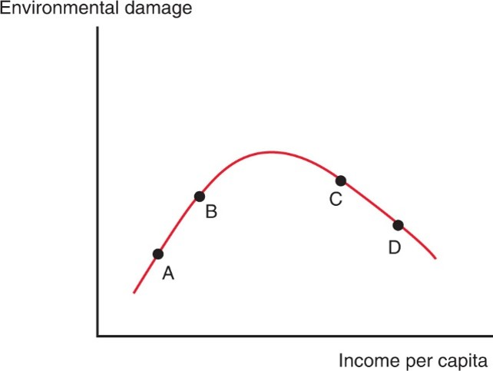
Figure 12.3 The Environmental Kuznets Curve
Empirical evidence suggests that as economies grow, they initially do increasing environmental damage—but they become more environmentally friendly once they become sufficiently rich. China, where the environment is deteriorating as the economy expands, is in effect moving from A to B. Richer countries may be moving from C to D, using some of their growth to improve the environment.
Notes:
The Kuznets Curve plots environmental damage versus income per capita. The curve is a modified upside down U shape, with the right side falling less steeply than the left side. 4 points are plotted from left to right: Ay and B on the left side of the peak and C and D on the right side.

Slide 34
Trade and the Environment (4 of 5)
Because rich countries usually have strict environmental regulations and poor countries do not, environmentally hazardous activities may be moved to poor countries.
A pollution haven is a place where an economic activity that is subject to strict environmental controls in some countries is moved to (sold to) other countries with less strict regulation.
Yet, there is evidence that pollution havens are insignificant relative to the pollution that occurs without international trade.

Slide 35
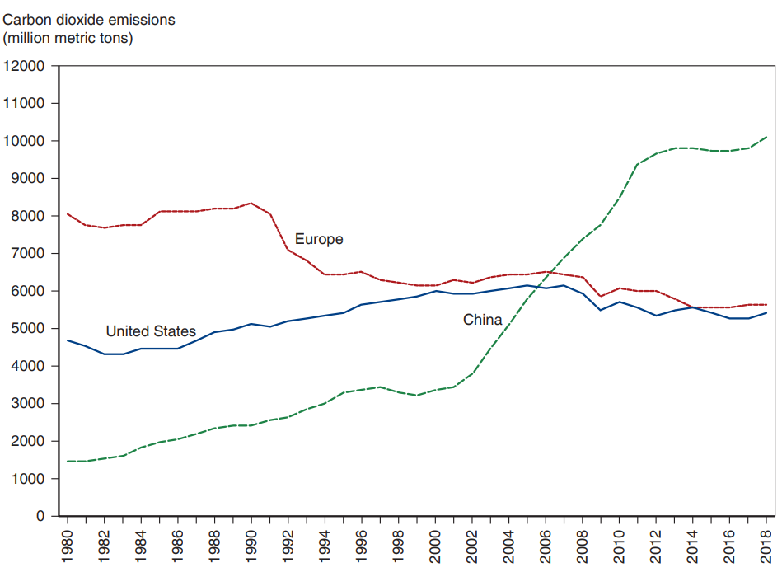
Figure 12.4 Carbon Dioxide Emissions
The rapid economic growth of China has turned it from a minor factor in climate change to the world’s largest emitter of carbon dioxide.
Source: Global Carbon Project.
Notes:
The triple line graph plots carbon dioxide emissions in millions of metric tons versus the year, 19 80 to 20 18, for the U S, Europe, and China. The plot for the U S generally rises from (19 80, 4,800) through (19 98, 5,900) to (2006, 6,000) and then generally falls to (20 18, 5,000). The plot for Europe generally falls from (19 80, 4,790) through (19 98, 4,300) to (20 18, 5,500). The plot for China generally rises from (19 80, 1,500) through (2001, 3,200) and then rises steeply to (20 18, 10,200). All values are estimated.

Slide 36
Trade and the Environment (5 of 5)
Pollution in some countries may cause a negative externality for other countries.
For example, production in China could cause air pollution in Korea (or on the West Coast of the United States).
To the degree that pollution causes negative externalities for other countries, they should want to include it in international negotiations.
Emissions of carbon dioxide is an example of pollution that causes a negative externality and that has been included in international negotiations.

Slide 37
Trade and Culture
Some activists believe that trade destroys culture in other countries.
This belief neglects the principle that we should allow people to define their culture through the choices that they make, not through standards set by others.
Also, any economic change, not just trade, leads to changes in everyday life.

Slide 38
Summary (1 of 3)
One argument for an activist trade policy is that investment in high-technology industries produces externalities for the economy.
But it is hard to identify which activities produce externalities and if so, to what degree they do.
A second argument for an activist trade policy is that governments can give domestic firms a strategic advantage in industries with excess profits.
But it is unclear if such a policy would succeed at giving a firm a strategic advantage or if it would be worthwhile.

Slide 39
Summary (2 of 3)
Some have opposed free trade because of the fact that workers in low- and middle-income countries earn lower wages and have worse working conditions than workers in high-income countries.
But workers in low- and middle-income countries are predicted to have lower wages due to lower productivity, yet still have higher wages compared to their situation without trade.

Slide 40
Summary (3 of 3)
Some have proposed that trade negotiations should involve labor, environmental, or “cultural” standards, but these standards are generally opposed by governments of low- and middle-income countries.

Slide 41

Copyright
This work is protected by United States copyright laws and is provided solely for the use of instructors in teaching their courses and assessing student learning. Dissemination or sale of any part of this work (including on the World Wide Web) will destroy the integrity of the work and is not permitted. The work and materials from it should never be made available to students except by instructors using the accompanying text in their classes. All recipients of this work are expected to abide by these restrictions and to honor the intended pedagogical purposes and the needs of other instructors who rely on these materials.

